Slide 1

COURIER MANAGEMENT SYSTEM A WEB-BASED APPLICATION FOR TRACKING AND MANAGING COURIERS
MALLA REDDY INSTITUTE OF ENGINEERING AND TECHNOLOGY
DEPARTMENT OF INFORMATION TECHNOLOGY
TEAM LEAD: SHAIK LATEEF TEAM MEMBERS:
ESHA HARIDAS SHIVU KUMAR VADLA PRAVLEKA SAI SIDHARTHA ALETI
HEAD OF THE DEPARTMENT: MR.V. RAMAKRISHNAN
GUIDE: MR KHATHA MAHENDAR

Slide 2
CONTENTS
ABSTRACT INTRODUCTION EXISTING SYSTEM EXISTING SYSTEM AND LIMITATIONS PROPOSED SYSTEM ADVANTAGES OF PROPOSED SYSTEM
SEQUENCE DIAGRAM METHODOLOGY SYSTEM REQUIREMENTS
OUTPUT SCREENS FUTURE ENHANCEMENTS AND UPGRADES CONCLUSION

Slide 3
ABSTRACT
The Courier Management System is a web-based application designed to streamline the logistics and courier services industry. The proposed system aims to provide a seamless and efficient experience for customers, courier companies, and delivery personnel. By leveraging Google Maps API and real-time tracking, the system enables customers to monitor their packages and receive timely updates.
The system also features a user feedback mechanism, allowing customers to rate and review their experiences. Additionally, the system provides courier companies with a centralized platform to manage their operations. The proposed system offers a scalable and secure solution, addressing the limitations of existing courier management systems. With its user-centric design and advanced features, the Courier Management System has the potential to revolutionize the logistics industry.
KEYWORDS:
Courier Management System,Logistics and Courier Services,Real-time Tracking,Google Maps API,
User Feedback Mechanism,Scalable

Slide 4
INTRODUCTION
The logistics and courier services industry has experienced rapid growth in recent years, driven by the increasing demand for fast and reliable delivery services. With the rise of e-commerce, the need for efficient and effective courier management systems has become more pressing than ever. Traditional courier management systems often rely on manual processes, leading to inefficiencies, delays, and a lack of transparency. Moreover, the absence of real-time tracking and monitoring capabilities makes it challenging for customers to stay informed about the status of their packages.

Slide 5
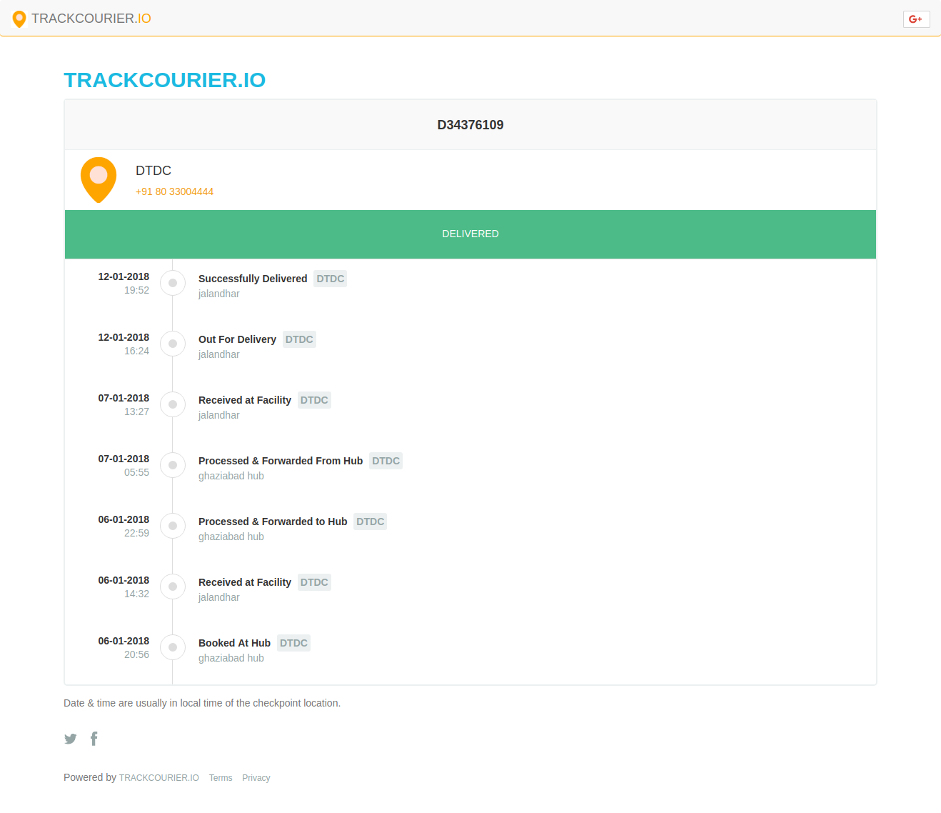
EXISTING SYSTEM
Current courier management systems are inefficient, lacking real-time tracking and updates, which leads to frustrated customers, delayed deliveries, and operational inefficiencies, resulting in increased costs and decreased customer satisfaction.
DTDC COURIER TRACKING

Slide 6

EXISTING SYSTEM LIMITATIONS
Lack of real-time tracking and updates
Manual errors and delays
Poor customer satisfaction
Inefficient operations and resource allocation
Incompatibility with Emerging Technologies

Slide 7
PROPOSED SYSTEM
Our web-based courier management system provides real-time tracking and improved customer satisfaction. With our system, customers can track their packages in real-time, and administrators can manage courier operations efficiently. Additionally, administrators can use customer feedback to analyze and further update the services, leading to continuous improvement.
The system is built using a robust and scalable architecture, ensuring high availability and performance. It features a user-friendly interface, real-time tracking, efficient courier operations, and customer feedback analysis. By implementing our system, courier companies can enhance customer satisfaction, improve operational efficiency, and drive business growth.

Slide 8
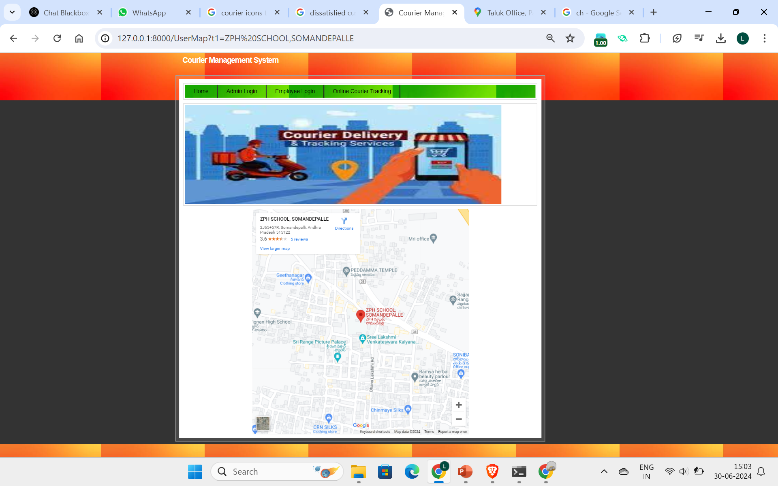

Slide 9
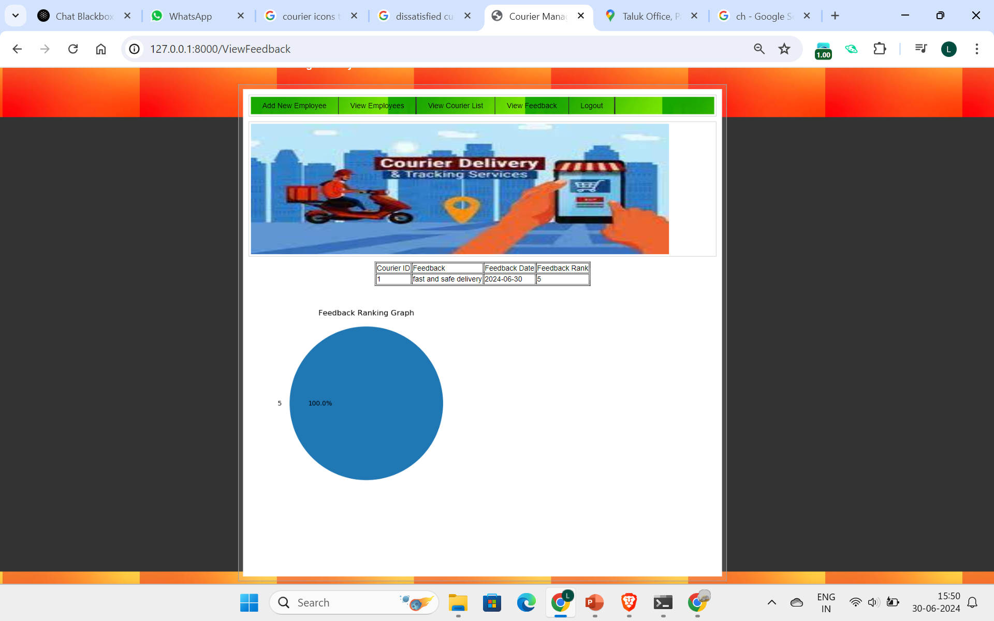

ADVANTAGES OF PROPOSED SYSTEM
Real-time tracking
Improved customer satisfaction
Increased efficiency and productivity
Continuous improvement through customer feedback
User Friendly Interface
Competitive Advantage

Slide 10
SEQUENCE DIAGRAM

Slide 11
METHODOLOGY
Our project followed a structured methodology to ensure a robust and scalable solution. We began with requirements gathering, analyzing the needs of admins, employees, and customers. We then designed the system architecture, database schema, and user interface, ensuring scalability, flexibility, and user-friendliness. Development was done using the Django framework, a high-level Python web framework, and SQL for storage, providing a robust and efficient data management system. Thorough testing, including unit testing, integration testing, and system testing, ensured the system met requirements and was bug-free.

Slide 12
SYSTEM REQUIREMENTS
Processor :i3 or above Ram :4 GB HardDisk:40GB
Operating System: Windows Browser: Any Browser

Slide 13
TECHNOLOGIES USED:
Frontend:
HTML,CSS,JavaScript Backend:
Python Framework:
Django Database:
SQL

Slide 14
OUTPUT SCREENS
MAP FEATURE
USER FEEDBACK

Slide 15
FUTURE ENHANCEMENTS AND UPGRADES
AI and ML Integration Intelligent customer service chatbots
IoT Integration Real-time package tracking with IoT sensor IoT-enabled vehicles for efficient delivery
Blockchain Integration Immutable records of package delivery and status
By integrating emerging technologies such as AI, IoT, blockchain, autonomous delivery, and augmented reality, our courier management system will continue to evolve and improve, providing even greater efficiency, transparency, and customer satisfaction."

Slide 16
CONCLUSION
The proposed web-based courier management system offers a comprehensive solution for courier companies to improve operational efficiency, enhance customer satisfaction, and drive business growth. By leveraging real-time tracking, automated processes, and data-driven decision making, courier companies can gain a competitive edge in the market. The system's scalability, flexibility, and user-friendly interface make it an ideal solution for businesses of all sizes. Implementing this system can lead to cost savings, increased customer loyalty, and ultimately, increased revenue and profitability. The proposed system is poised to revolutionize the courier industry and set a new standard for delivery services.

Slide 17
THANK YOU

